Slide 1
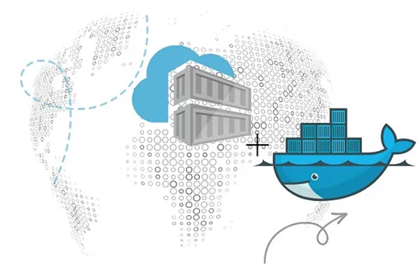
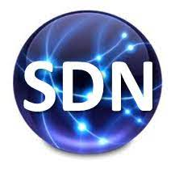
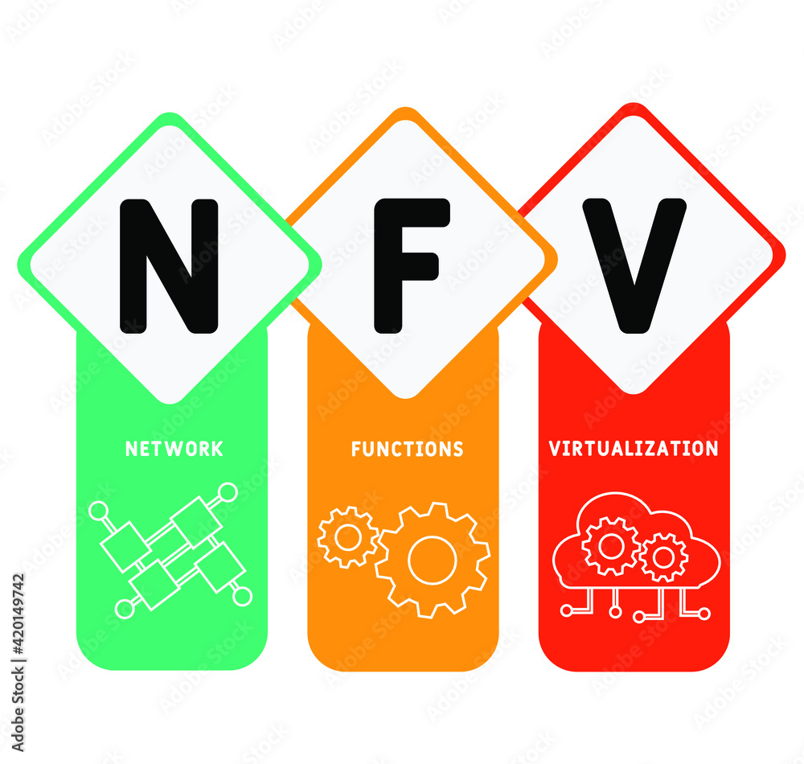
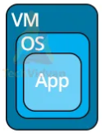
PDS
Computer Vision
Multicloud Kubernetes Cluster on AWS and Azure
.
https://github.com/siagianp
https://www.youtube.com/@AmelOline/videos
https://github.com/amelcharolinesgn2/IoT_simulator-mqtt-NodeRed
https://github.com/amelcharolinesgn2/Cloud-Infrastructures
Notes:
https://www.netapp.com/learn/cvo-blg-how-to-build-a-multicloud-kubernetes-cluster-in-aws-and-azure/

Slide 2


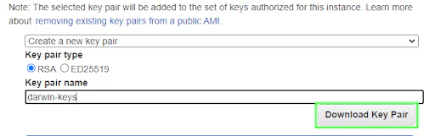

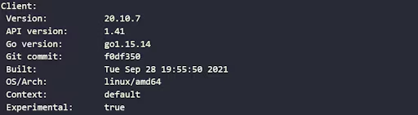
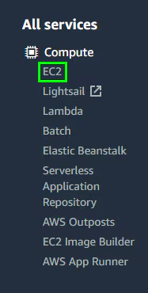
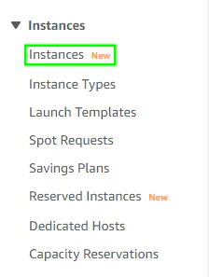

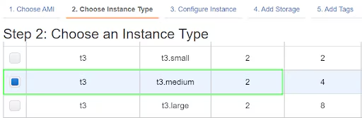
Content
Multicloud Kubernetes Cluster on AWS and Azure (Con’s)
Why Deploy a Kubernetes Cluster Across Multiple Clouds?
How to Set Up a Multicloud Kuberentes Cluster on AWS and Azure
1. Configuring the Master Node on AWS
1.1 Setting Up the EC2 Instance
1.2 Setting up the Kubernetes Master Node
2. Configuring Worker Nodes in Azure and AWS
2.1 Creating the Azure Virtual Machines
2.2 Creating the AWS EC2 Virtual Machine
2.3 Installing Docker and Kubernetes on the Nodes
3. Troubleshooting the Multicloud Cluster Setup
1. Configuring the Master Node on AWS
Notes:
https://www.netapp.com/learn/cvo-blg-how-to-build-a-multicloud-kubernetes-cluster-in-aws-and-azure/

Slide 3

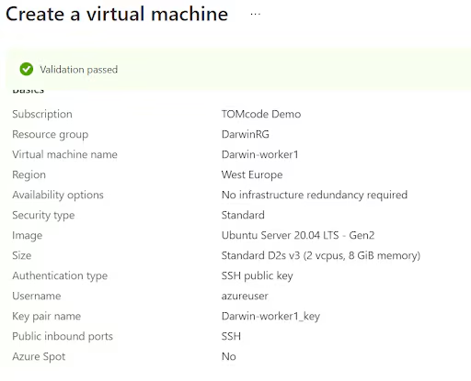
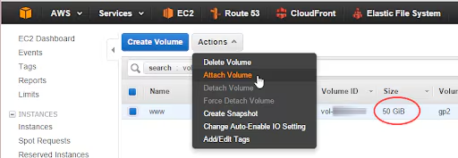


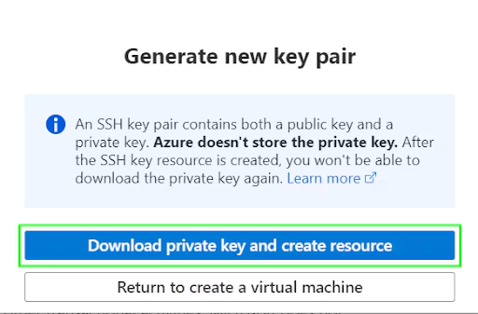
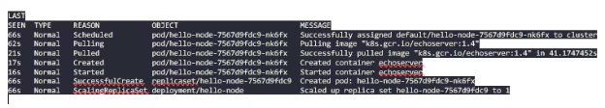
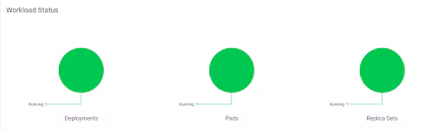
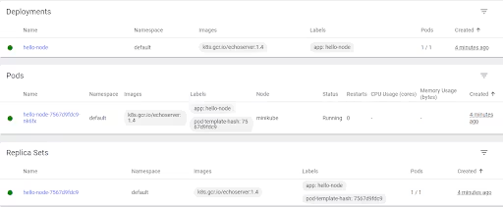

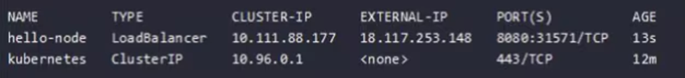
Multicloud Kubernetes Cluster on AWS and Azure (Con’s)
2. Configuring Worker Nodes in Azure and AWS
3. Troubleshooting the Multicloud Cluster Setup

Slide 4
Multicloud Kubernetes Cluster on AWS and Azure (Con’s)

Slide 5
Multicloud Kubernetes Cluster on AWS and Azure (Con’s)

Slide 6
Multicloud Kubernetes Cluster on AWS and Azure (Con’s)

Slide 7
Multicloud Kubernetes Cluster on AWS and Azure (Con’s)

Slide 8
Multicloud Kubernetes Cluster on AWS and Azure (Con’s)

Slide 9
Multicloud Kubernetes Cluster on AWS and Azure (Con’s)

Slide 10
Multicloud Kubernetes Cluster on AWS and Azure (Con’s)

Slide 11
Multicloud Kubernetes Cluster on AWS and Azure (Con’s)

Slide 12
Multicloud Kubernetes Cluster on AWS and Azure (Con’s)

Slide 13
Multicloud Kubernetes Cluster on AWS and Azure (Con’s)

Slide 14
Multicloud Kubernetes Cluster on AWS and Azure (Con’s)

Slide 15
Multicloud Kubernetes Cluster on AWS and Azure (Con’s)

Slide 16
Multicloud Kubernetes Cluster on AWS and Azure (Con’s)

Slide 17
Multicloud Kubernetes Cluster on AWS and Azure (Con’s)

Slide 18
Multicloud Kubernetes Cluster on AWS and Azure (Con’s)

Slide 19
Multicloud Kubernetes Cluster on AWS and Azure (Con’s)

Slide 20
Kubernetes For AI Hyperparameter Search Experiments |

Slide 21
Github
Automate provisioning in the self-service platform
Notes:
https://conferences.oreilly.com/artificial-intelligence/ai-ny-2019/public/schedule/detail/72321.html
https://s.itho.me/events/2019/k8s/1525-1605%20%E5%BC%B5%E5%AE%B6%E6%A3%A0_AI%20on%20Kubernetes.pdf
https://medium.com/hackernoon/gpus-kubernetes-for-deep-learning-part-1-3-d8eebe0dd6fe
https://github.com/alibaba/GPU-scheduler-for-deep-learning

